Slide 1
A Phenotypic Clinical Approach to Mold-Related Illness
Dr. James R. Conway, ND

Slide 2
Overview
Phenotypic Approach
Case #1
3 Quick Crash Courses
Case #2

Slide 3
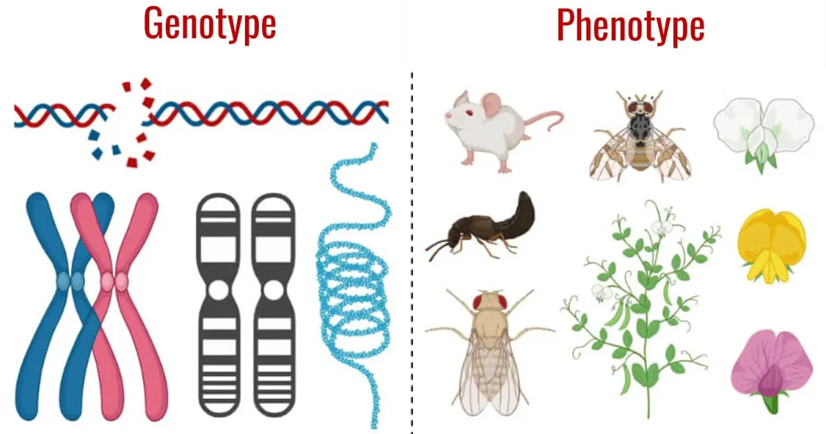
Phenotypes: Clinical utility of a genetics concept
A phenotype is the set of observable characteristics or physical traits of an organism. It is determined by the interaction between an individual's genetic makeup (genotype) and environmental factors.
Notes:
https://dashamlav.com/uploads/resized/2021/12/genotype-vs-phenotype-dashamlav-feat.webp

Slide 4
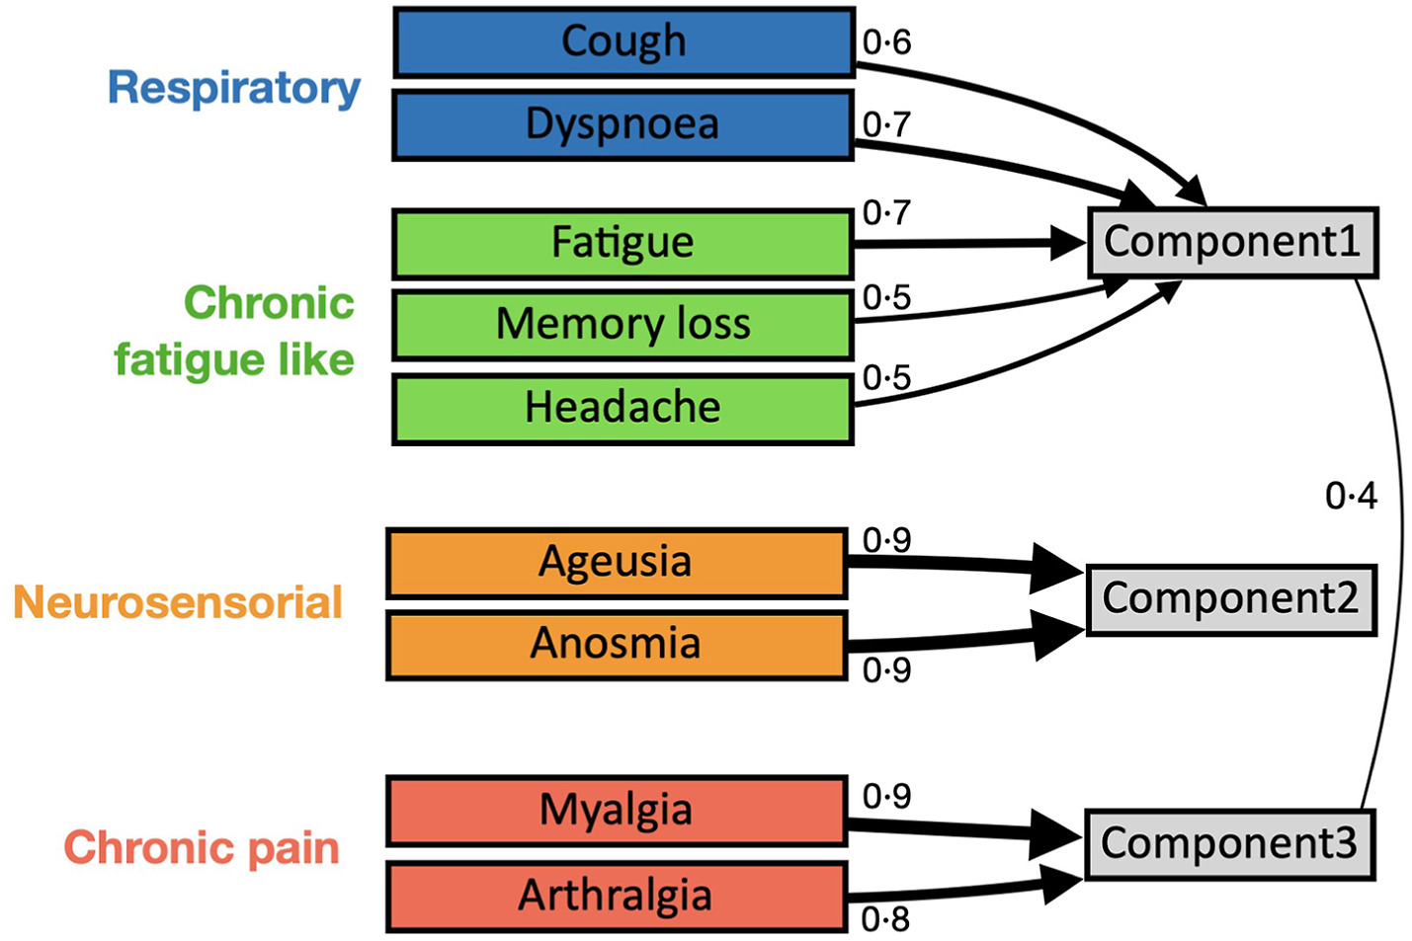
Phenotypes: Clinical utility of a genetics concept
Clinical Phenotypes associated with Post Covid-19 Syndrome
Clinical phenotypes and quality of life to define post-COVID-19 syndrome: a cluster analysis of the multinational, prospective ORCHESTRA cohort
Notes:
https://www.thelancet.com/journals/eclinm/article/PIIS2589-5370%2823%2900284-5/fulltext

Slide 5
Applications of a phenotypic approach
Frames an otherwise very complicated case
Helps to prioritize treatment strategies
Build a list of differentials and comorbidities

Slide 6
Phenotypes
Systematic (Organic): Respiratory, Sinus, Urinary, Gut
Myalgic: Fibromyalgia, chronic pain
Asthenic: Chronic fatigue, ME/CFS
Histaminic: MCAS, histamine intolerance, rhinosinusitis, eczema
Microbic: Virus, Bacteria, Parasite
Vectoric: MSIDS, Chronic Lyme, Co-infections
Neurologic: PD, MS, Seizure (atypical), Parasthesias
Toxic: HMs, Chemicals, Pesticides
Endocrinic: Sex hormone imbalances, HPA axis, fertility
Dysautonomic: Orthostasis, CV, POTS, 1°/2° Dysautonomias
Immunologic: Autoimmune, Immune suppression, Dysreg
Carcinogenic: paraneoplastic syndromes, cancer
Dysbiotic: gastritis, SIBO, colitis, motility disorders
Psychotic: Psychosis, Derealization, Depersonalization

Slide 7
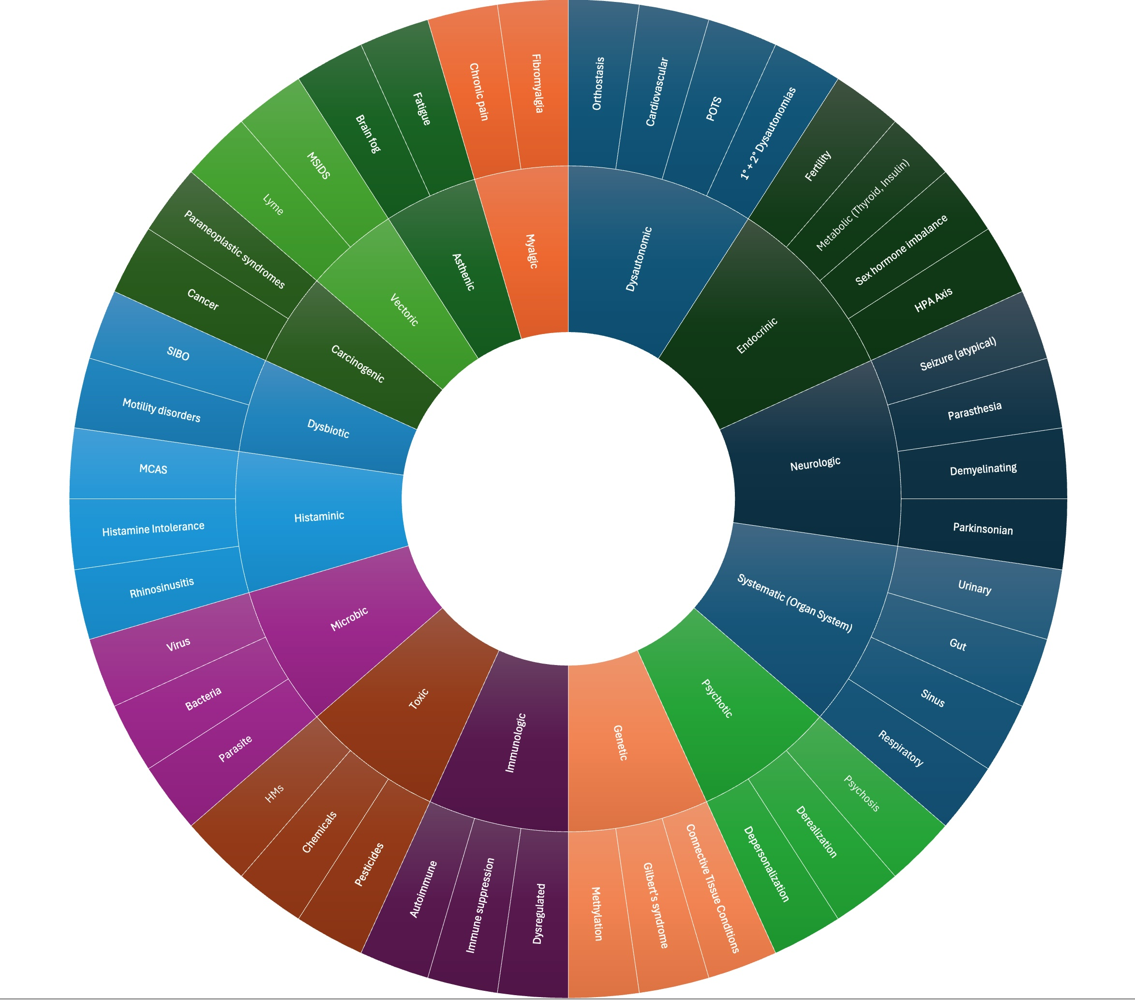
Mold-related
Phenotypes

Slide 8
Case #1 — Myalgic Phenotype
S// (first visit, Oct 2025)
SA: 76 yo F
CC: chronic severe pain (fibromyalgia) x 32 yrs, onset after MVA
MVA: rear-ended; “since then whole body has been in pain”
Key locations: shoulders, hips
Pain is changing/moving all the time
4/10 and then progresses to “out of control” ; tx acupuncture prn
Hasn’t and doesn’t want any pharmaceuticals

Slide 9
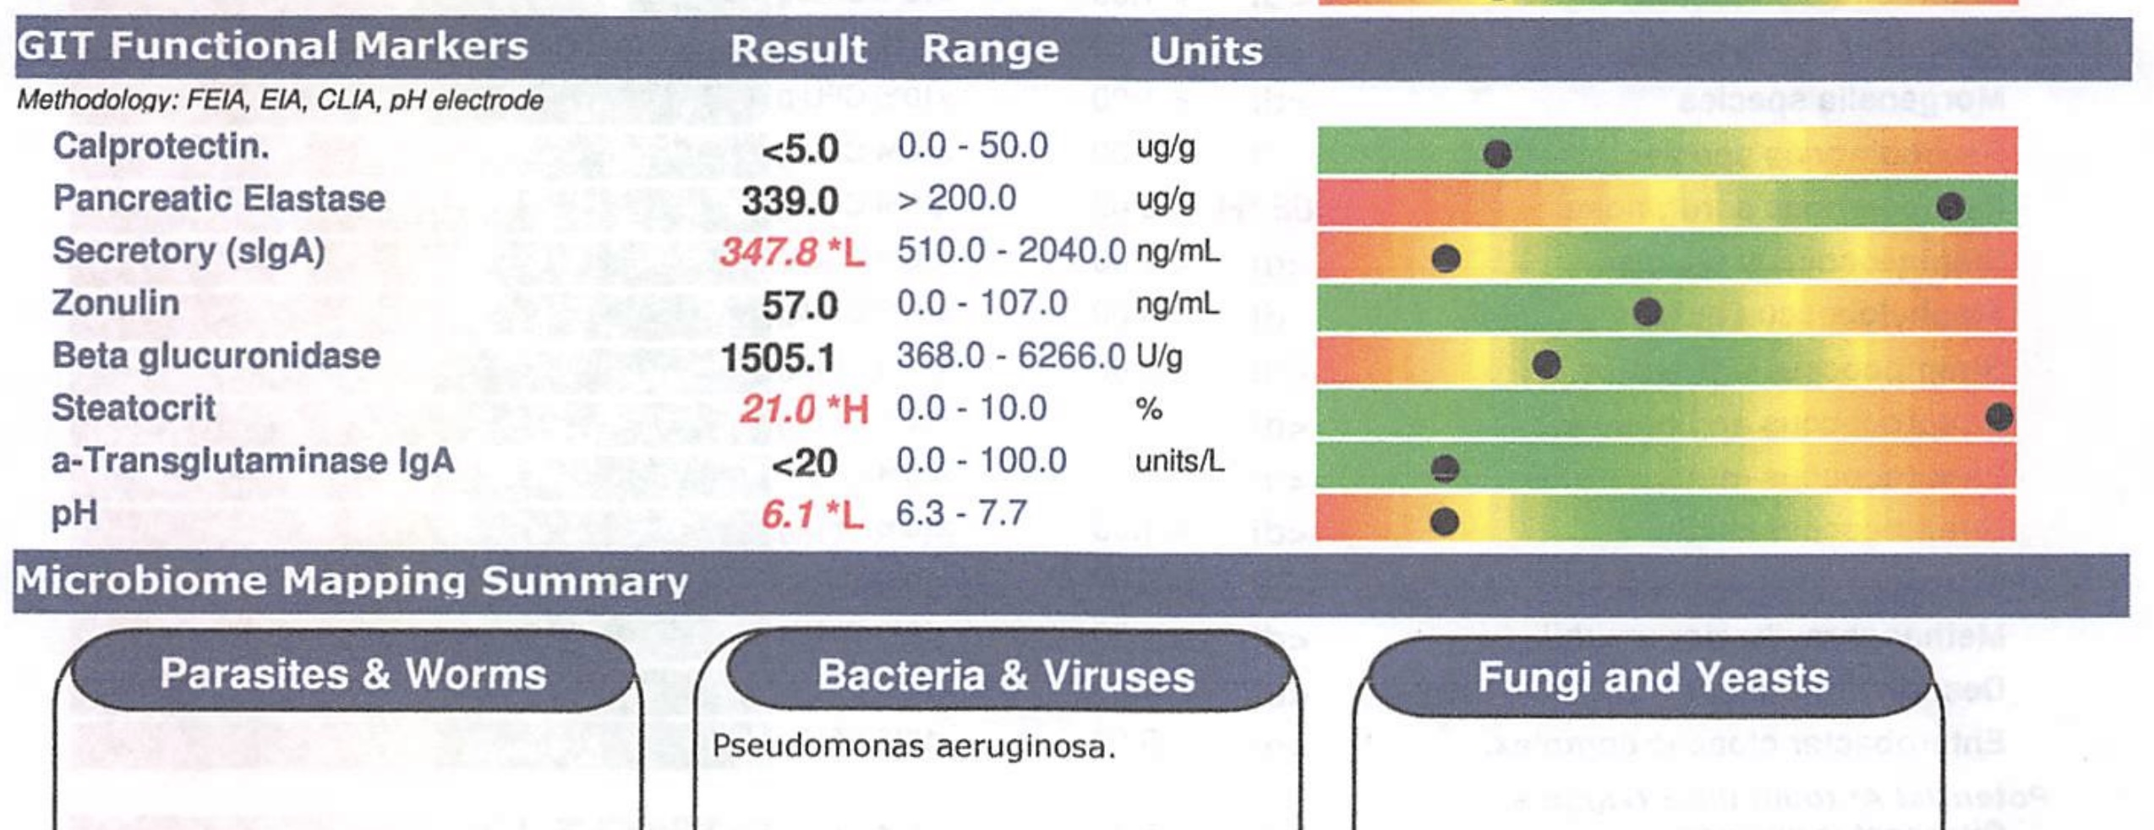
Case #1 — SA - Myalgic
Enviro: current home x 36 yrs; “no known mold”; recent years pesticides at farm next door
Saw previous ND: stool microbiome testing b/c of loose stools for decades; dramatically improved with the pseudomonas aeruginosa tx (still occasions of loose BMs +/– heartburn)
O//

Slide 10
Case #1 — SA - Myalgic
A// Chronic migrating myalgia (fibromyalgia)
P//
Updated labs (CRP, CK, ANA, RF, Anti-CCP, Anti-dsDNA, Ferritin, Vit B12, Vit D, Fasting insulin, CMP)
Mycotoxin Urine Test – provoked w/ GSH x4 days
MSIDS and CIRS screening questionnaires (did not complete)
Rule out PMR, AI or inflammatory condition + imaging (hadn’t been seen by conventional medical team in some time)
Continue her current supplements: Vit D, K, CoQ10, Bell’s D&N, Reishi, Lion’s Mane, Gingko, Gastromend HP, Citrus Bergamot, and Mg

Slide 11
Case #1 — SA - Myalgic
S// (return visit, Dec 2025)
Recalls no pain when she went to Palm Springs a few yrs ago and that she is intermittently itchy the last few yrs
Severe pain Rt glute w/ a recent IMS tx
Disclosed has a “good-sized” drink QHS
O//
GP LL results: elevated LFTs, low B12; all other WNL
Mycotoxins: positive OTA, TCTs, and ZEN (negative AF and GT)

Slide 12
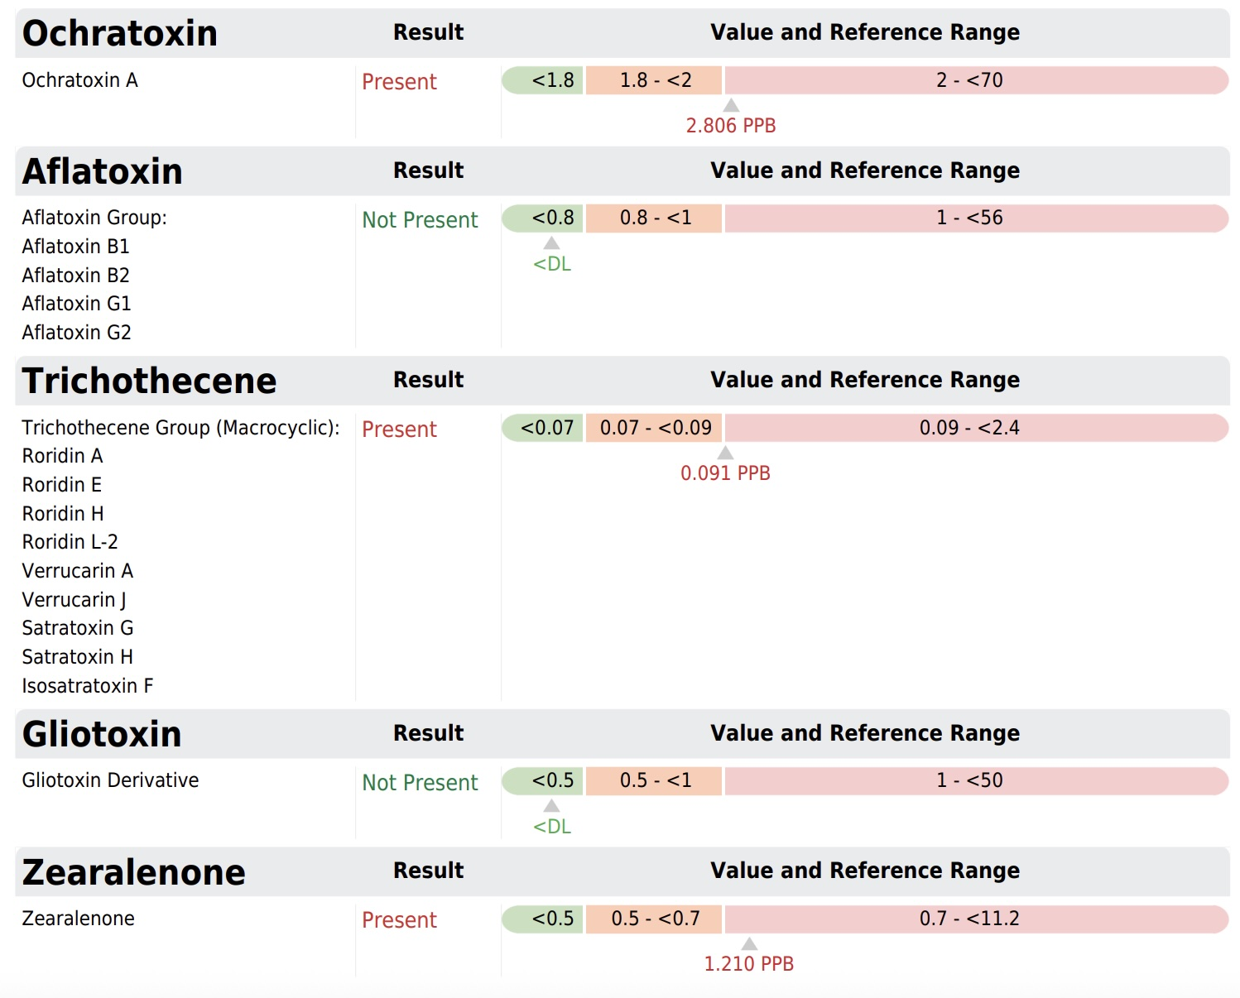
ELISA – provoked 450mg GSH PO QD x 4 days

Slide 13
Case #1 — SA - Myalgic
P//
Recommended my local mold inspector – Josh at BuildingHealth.Ca
Counselled EtOH reduction d/t LFTs
B12/B9 injection
Detox Protocol – slow introduction in the following order
Basic B Complex: 2 caps once daily with food (breakfast or lunch)
Indication: to support liver and address low B12
Resveratrol: 1 cap 2x/day - am and noon
Indication: antioxidants
TUDCA: 1 cap 2x/day with food
Indication: bile outflow and liver support
Liver GI Detox: 1 cap 2x/day with food
Indication: liver and detox support
Chlorella Tablets: start at 1 tablet 2x/day and slowly increase to full dose of 3 tabs 2x/day
Indication: starter binder - OTA

Slide 14
Case #1 — SA - Myalgic
S// (return visit, Jan 2026)
was in way more pain when first started detox, then pain was almost gone! the left-sided pain has been “so much better”
re Rt glute pain - found out that right trochanteric bursa was burst when they did IMS needles at the physio
cognition has improved
has avoided alcohol since last appointment
reports that now has confirmed fatty liver by u/s

Slide 15
Case #1 — SA - Myalgic
P// (return visit, Jan 2026)
Reminder about indication for in-home inspection
Sauna 3-4x/week (15-20 mins per session); hydrate well w/ electrolytes on sauna days; ensure high fiber diet
Additional prescriptions:
Holo Plexus: start at 1 cap daily and slowly increase to full dose of 3 caps once daily; take with a full glass of water; avoid taking alongside your other supplements by 1-2 hours
Indication: binder blend
Inflamma-LF: 1-2 caps 2x/day with food (you can take consistently or use 2 caps as needed when the pain flares)
Indication: anti-inflammatory - trial for the bursitis

Slide 16
Case #1 — SA - Myalgic
S// (return visit, Mar 2026)
ongoing Rt bursitis-related pain from IMS injury
she has full resolution of pain on the left hip, so she “knows things are working”
she decided to sell her house; she did get her bathroom checked and they found mold in the ceiling b/c the guys didn't seal the ceiling properly when they installed the shower (removed and then they used ozone machine to "kill everything") **INCOMPLETE REMEDIATION**
no additional in-home mold testing as she would rather move

Slide 17
Case #1 — SA - Myalgic
S// (return visit, Apr 2026)
she sold her house and will move to a new house (mold tested the new house and only slight mold which needs to be addressed)
her energy is not as good but attributes it to waking 2-3 AM and can't get back to sleep; she thinks it is stress from the move
the migrating myalgia cleared fully on the left and the only remaining sx is on the right (bursitis)

Slide 18
Case #1 — SA - Myalgic
P// (return visit, Apr 2026)
Discontinue: Inflamma LF, Holo Plexus, Liver GI Detox
Continue: TUDCA, Resveratrol, Chlorella (+ other supportive items)
NEW: Estro Matrix: 1 cap 2x/day (x 2 bottles and then stop)
Indication: advanced detox support
Continue with the high-fiber diet (fiber is nature's binder)
Visit booked for Aug 2026

Slide 19
3 Quick Crash Courses
Information Gathering
Mold Treatment
Supporting (Hyper) Sensitive People

Slide 20
Information Gathering
History taking (chronic complex cases AND straightforward)
Find the “light-switch” moment and look backward (decompensation: “never well since”) – timeline is often the key (move, flood, leak, renovations)
Keynote Sx: fatigue, brain fog, congestion, chronicity, urinary freq/urg
Peculiar Sx: odd parasthesias, “veil over eyes”, “internal vibrations”, etc.
Key Systems: sinuses, lungs, gut
Ask questions! Sequential, curious, suspicious
Questionnaires (Jill Crista, ND Mold, Richard Horowitz, MD MSIDS)
Screening (Visual Contrast Sensitivity)
Tests (urine, blood, environmental) + Mold Inspection
Provoked vs unprovoked

Slide 21

Mold Treatment (an approach)
Treat the person (manage Sx while working at root cause)
Get you out of mold so that you can get the mold out of you!
Antioxidants, antioxidants, antioxidants.
Liver + GALLBLADDER/BILE movement (gentle start!)
Binders (tiered by intensity and also based on testing)
Antifungals and antimicrobials (including intranasal +/– pulmonary)
Diet: fiber (nature’s binder), hydration++ (w/ electrolytes), low or no moldy foods/sugar/dairy/gluten
Advanced therapeutics: MAH/ozone (including insufflation), sauna, limbic system retraining
*Layer in treatments. Don’t add next items until tolerating first. Previous items will be rescue for reactions from next step items.
*This flow often changes if there are chronic/co-infections or comorbidities

Slide 22
Supporting (Hyper) Sensitive People
Start low and go slow. STOP if reactions (to prevent regression)
Some of the most complicated cases need the most simple Tx
Single ingredients first. Build your protocol.
Diagnosis spectrum: terrified OF a Dx → their identity IS their Dx
Often end up managing co-morbidities while slowly chipping away at root causes
Denial: a Sx of mold is being in denial about mold!
Finances: creative Tx plans, planning appointments, support
Many typical mold treatments don’t work for sensitive people
Freak them out, Chill them out!

Slide 23
Case #2 — Histaminic, Systematic, Microbic (dysbiotic) Phenotypes
S// (first visit, Mar 2024) **most return visits were phone calls**
TT: 2 yo M
CC #1: severe, full body eczema
  Onset 3 mos; breastfeeding + supplemental cow formula; worsened when stopped breastfeeding (less reactive goat formula)
CC#2: multiple food rxns (including 2 ER visits for anaphylaxis)
  Anaphylaxis: pea, flaxseed, egg + allergist recommended to keep 1 peanut in diet weekly
  Skin flares: dogs, cats, lots of foods
CC #3: “asthma”
  Reactive airways

Slide 24
Case #2 — TT - Histaminic, Systematic, Microbic (dysbiotic)
S// (first visit, Mar 2024)
Skin extremely pruritic, full body red by end of the day
Removed pets from home x 2 wks and the skin improved to the “best it had been”
Allergist recommended to stay on topical steroids daily (parents not comfortable with daily use)

Slide 25
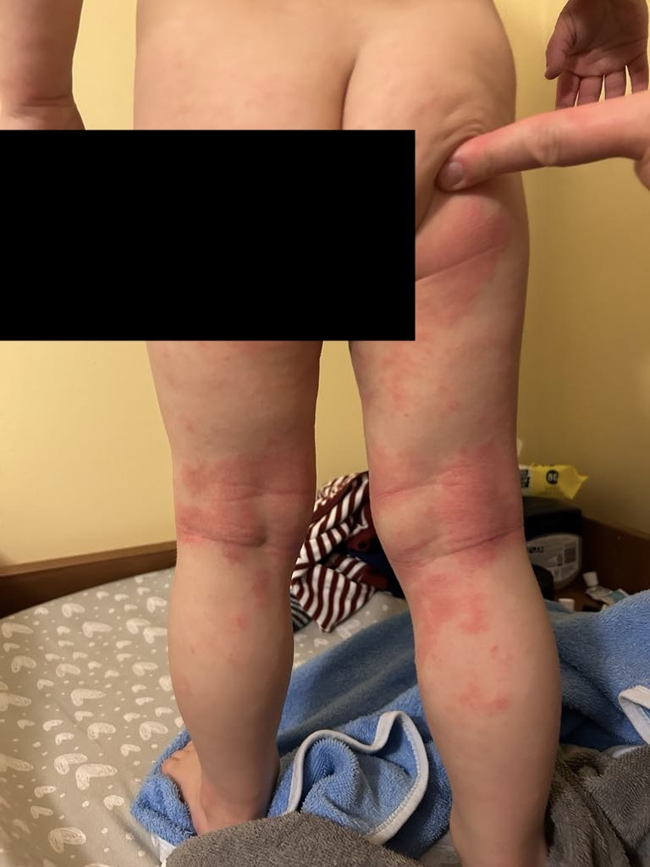
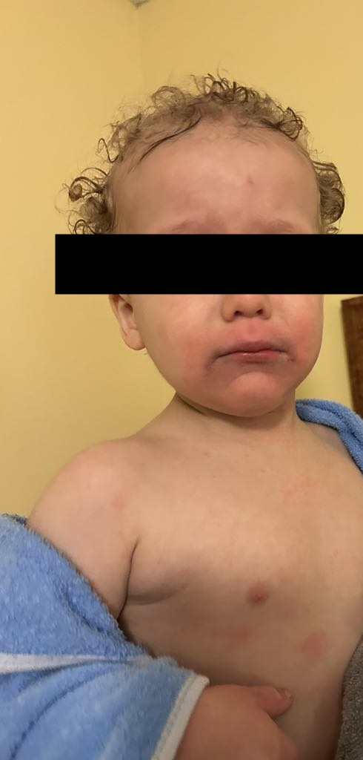
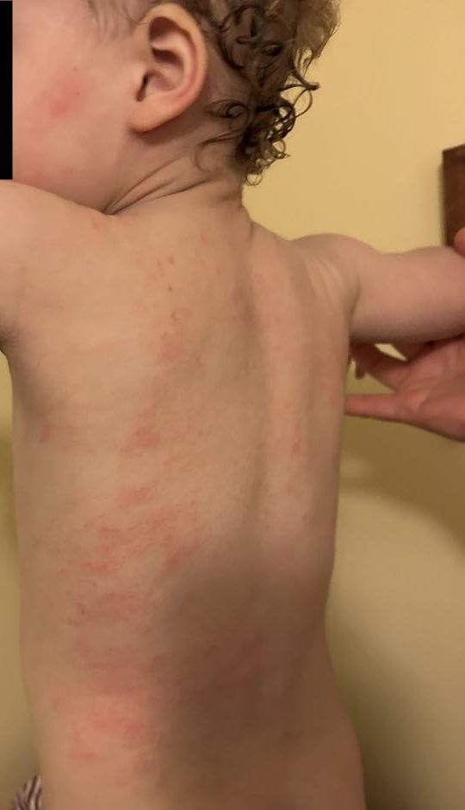
Case #2 — TT - Histaminic, Systematic, Microbic (dysbiotic)

Slide 26
Case #2 — TT - Histaminic, Systematic, Microbic (dysbiotic)
S// (first visit, Mar 2024)
Hx of very liquid stools; BMs are now more normal (but soft)
GI Map done by another health practitioner: pos clostridia, leaky gut, and dysbiosis ++
Reacted to all the items recommended
Self initiated:
  8 gtt sunbutyrate daily (d/t strong rxns at higher dose)
  Poorly tolerated previous proBx
  Serene Skin
  Cod Liver oil (tolerated)
  Vitamin D

Slide 27
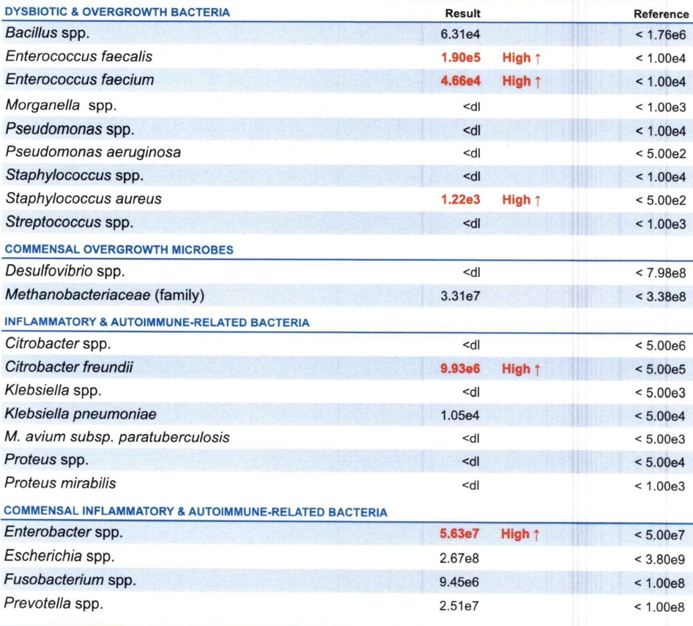
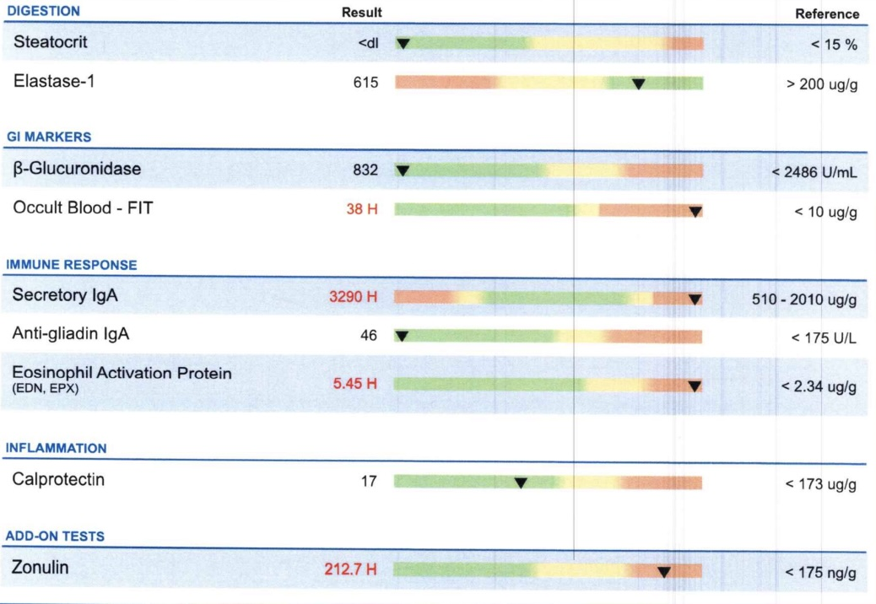
Case #2 — TT - Histaminic, Systematic, Microbic (dysbiotic)
TT GI MAP (Nov 2023)

Slide 28
Case #2 — TT - Histaminic, Systematic, Microbic (dysbiotic)
S// (first visit, Mar 2024)
mold inspection done by Josh (referral) — found aspergillus in main bathroom, furnace room
A// severe eczema, asthma, hx clostridia, dysbiosis, enviro mold
O// head-to-toe eczema (severe)
P//
Vega (electrodermal) digestive screen + detox/mold screen
Query mold factor; r/o clostridia persistence
High Potency Allergy Mix: start at 1 drop to ensure that tolerates; then use 6 drops once daily using additional doses for skin flares up to 5 doses daily
Indication: homeopathic blend for histamine
Quercetin (e.g. Vital Nutrients or Natural Factors): start w/ sprinkle on food; work up to 1/4 cap daily — adjusting dose as needed if any reactions
Indication: trial for histamine

Slide 29
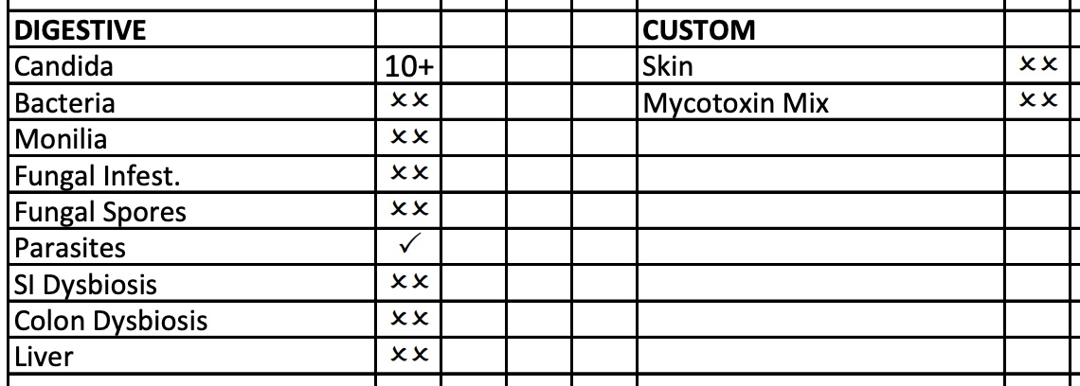
Case #2 — TT - Histaminic, Systematic, Microbic (dysbiotic)
S// (2nd visit, Apr 2024)
Tolerating HPAM; had to use steroid cream d/t a flare
Tolerating ¼ cap quercetin daily
O//
Vega

Slide 30
Case #2 — TT - Histaminic, Systematic, Microbic (dysbiotic)
P// (2nd visit, Apr 2024)
Phenolic Extract #1 [Livexx, System Detox, Infla, Intra-cell, Lymphexx, Dermexx]: start at 1 drop 2x/day diluted in small splash water; can increase gradually to full dose by adding 1 drop 2x every 1-2 days until reached 15 drops 2x/day. Once tolerated, can take doses directly by mouth - don't contaminate the dropper.
Indication: phenolic for skin / detox
Phenolic Extract #2 [Fungexx, Bacterexx, GI]: start at 1 drop 2x/day diluted in small splash water; can increase gradually to full dose by adding 1 drop 2x every 1-2 days until reached 12 drops 2x/day. Once tolerated, can take doses directly by mouth - don't contaminate the dropper.
Indication: phenolic for fungal / bacterial imbalances
Phenolic Extract #3 [Candida+]: start at 1 drop 2x/day diluted in small splash water; can increase gradually to full dose by adding 1 drop 2x every 1-2 days until reached 10 drops 2x/day. Once tolerated, can take doses directly by mouth - don't contaminate the dropper.
Indication: phenolic for candida
Bifidonate Probiotics: 1/8 tsp increasing to 1/4 tsp twice daily — added to water or fruit sauce (e.g. applesauce). Lower dose if loosens stool or causes upset stomach.
Indication: probiotics to address imbalances in the gut flora
Slippery Elm Bark Powder: 1/8 tsp increasing to 1/4 tsp twice daily — added to warm water or fruit sauce (e.g. applesauce)
Gut healing powder - is a source of fiber, so ensure ample fluids so that not constipating (this may actual help to firm up stools)

Slide 31
Case #2 — TT - Histaminic, Systematic, Microbic (dysbiotic)
S// (3rd visit, May 2024)
Up to full dose of the drops a few days ago
Athletes foot both feet; cradle cap and penile yeast infection — thinks that then caused a UTI
UTI and flared w/ the Abx - needed steroid to address the flare of the skin; using the steroid sparingly
Chest x-ray d/t small asthma attacks; using puffer to open the lungs
Looking to move vs investigating the mold in current mold
BMs - has been more constipated; tried prune juice; BMs once q 28 hrs; harder

Slide 32
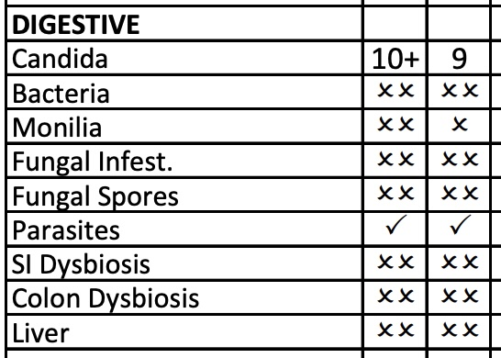
Case #2 — TT - Histaminic, Systematic, Microbic (dysbiotic)
O// (3rd visit, May 2024)
Updated Vega

Slide 33
Case #2 — TT - Histaminic, Systematic, Microbic (dysbiotic)
P// (3rd visit, May 2024)
Uva Ursi Glycerite: 20 drops 3x/day in glass of water for 7-8 days (at least 2 days after full resolution of symptoms and clear urine test)
Indication: antimicrobial for urinary tract
Continue previous phenolics and self-initiated items
Return if UTI doesn’t clear

Slide 34
Case #2 — TT - Histaminic, Systematic, Microbic (dysbiotic)
S// (4th visit, July 2024)
eczema “98%” clear; has stopped the steroid use; occasional hydrocortisone 0.5% a couple times per week if severe; still some areas behind the knees + hands
no more scratching his head
re asthma: much improved! inhaler only once weekly
CC: some hives lately on face - small, pustule in the centre of the hives, they then rupture
occasions of a few random spots; unknown cause
and then 2-3x/week will have full patch of ~30 small hives on hand (e.g. after banana which hasn't had an issues with before)
feels 'contact' could be triggering
when slippery elm contacts the skin he will get a hive... Curious if could cause the hives
thinks that hives are more prominent when pollens are high outside
re urinary tract - last episode got culture done and was clear
keeps on grabbing at penis; can be quite irritated — ? oxalates, penile candidiasis

Slide 35
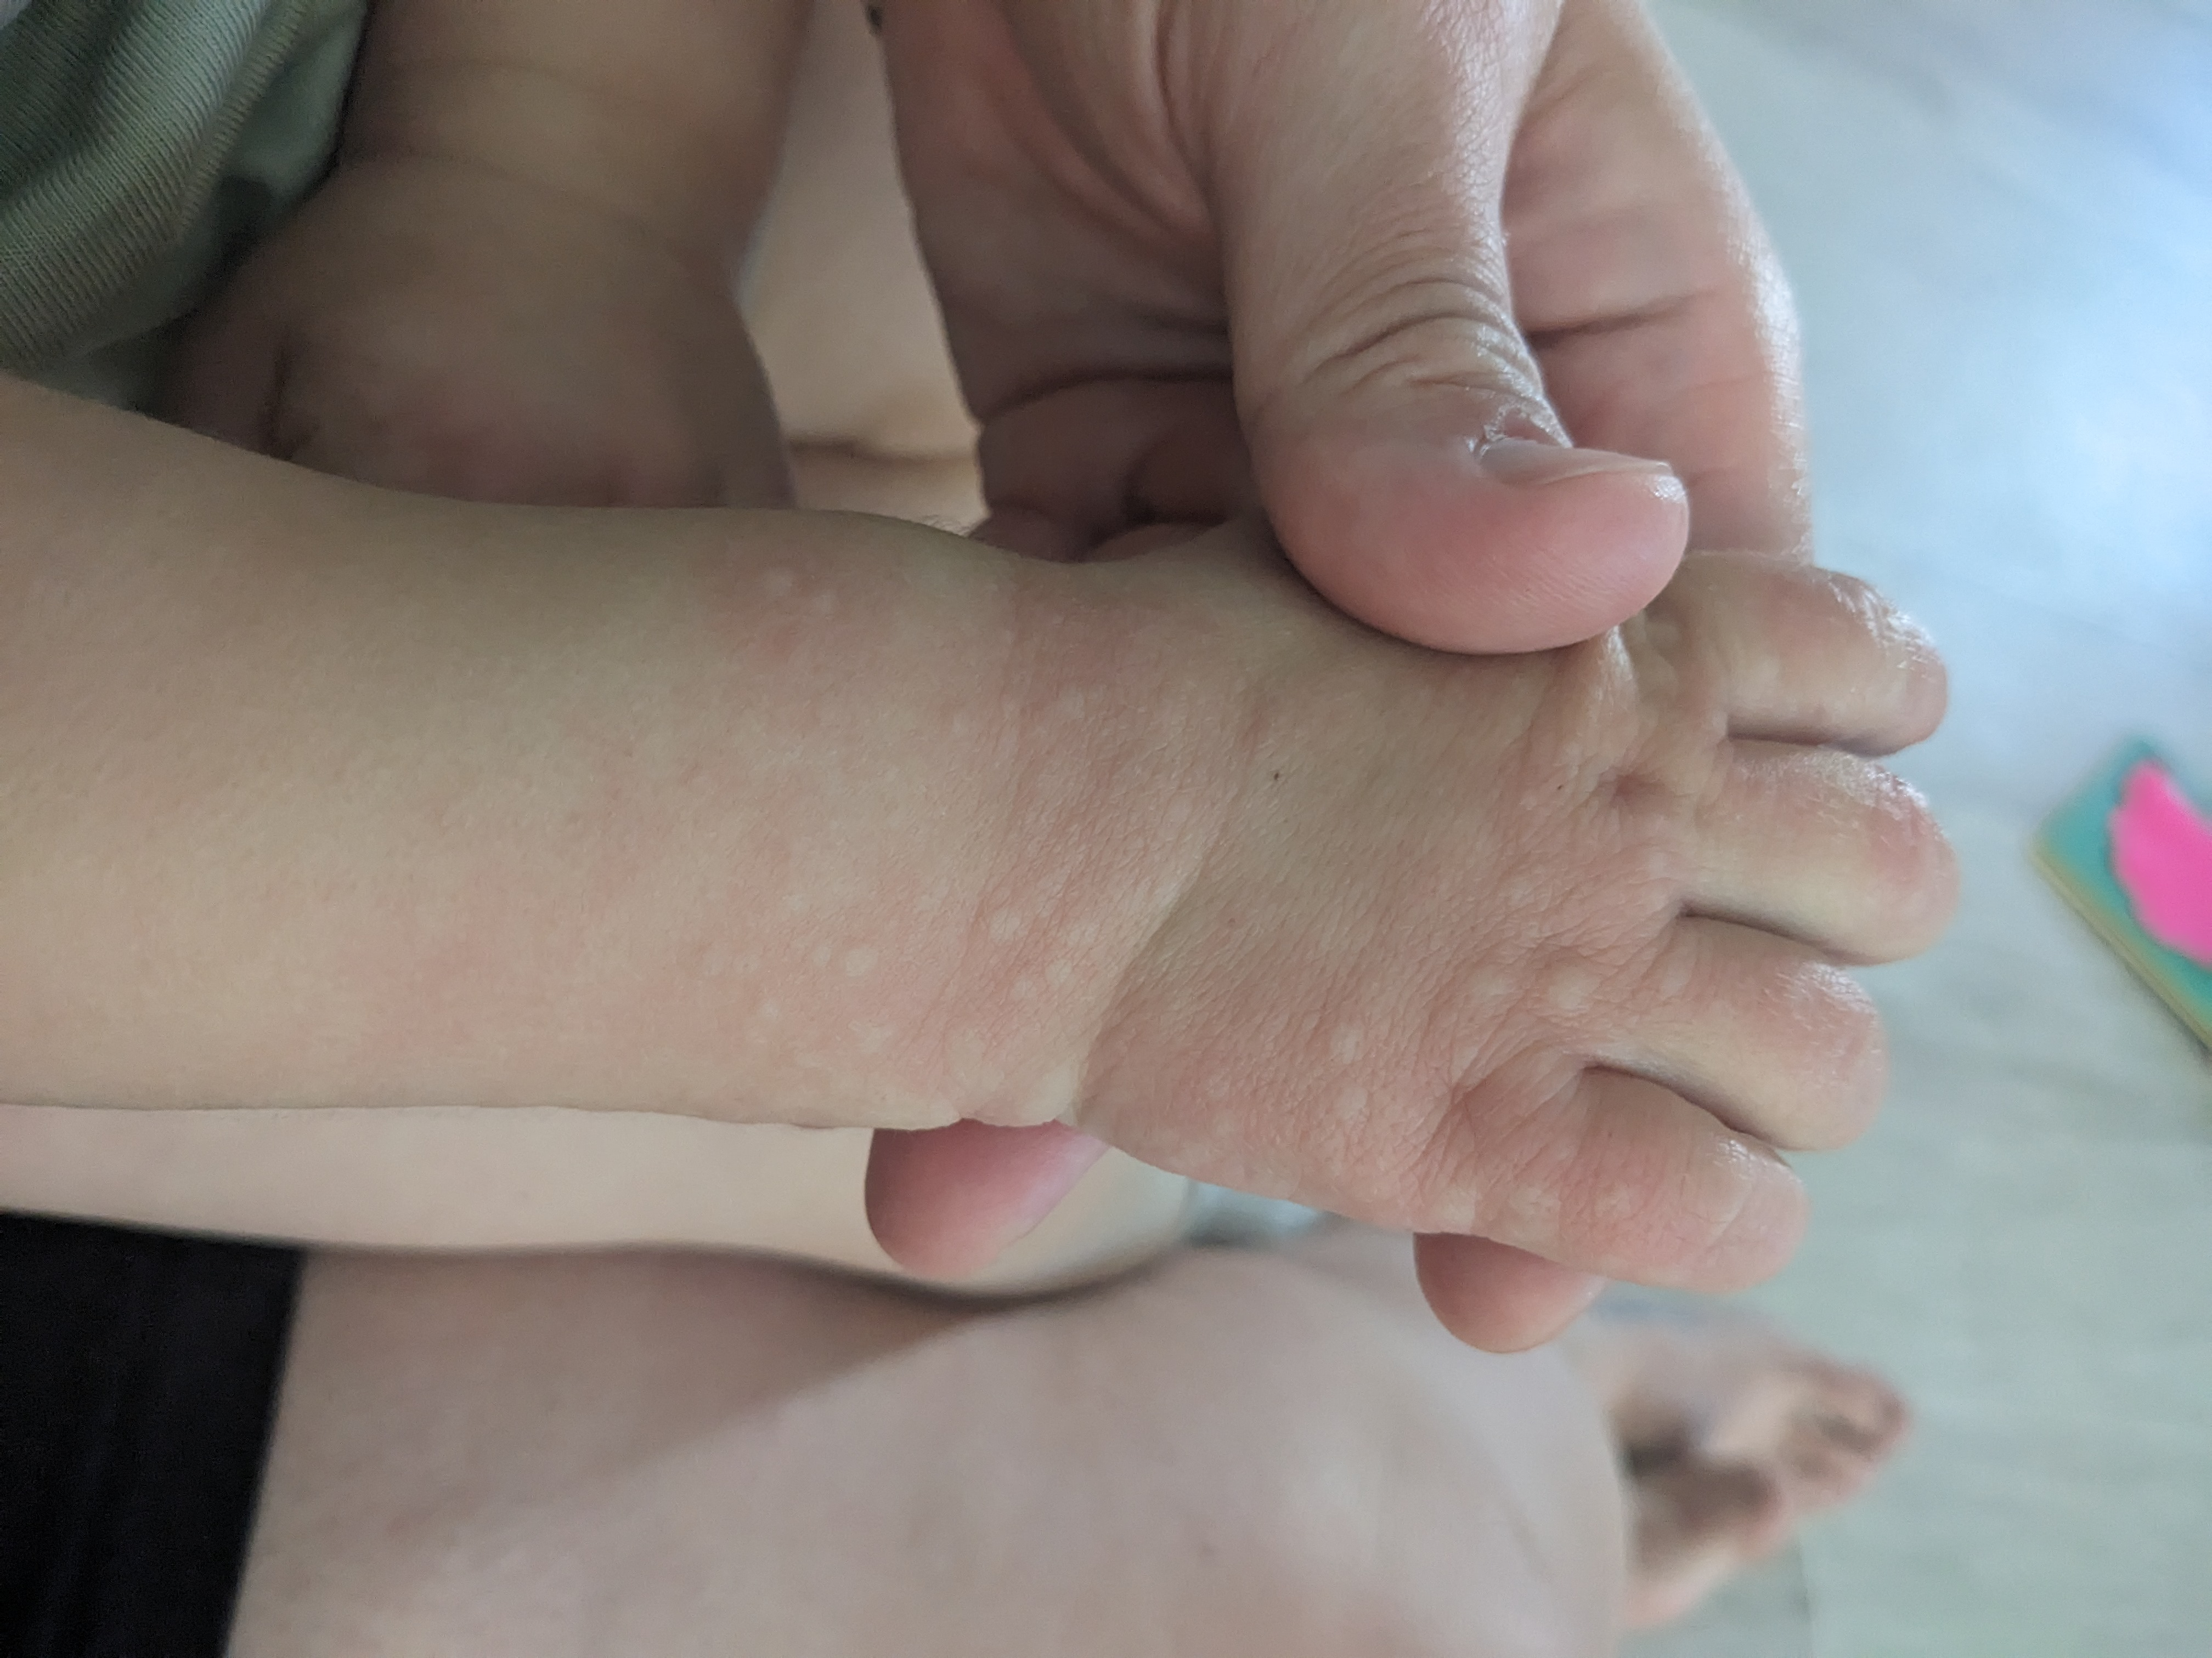
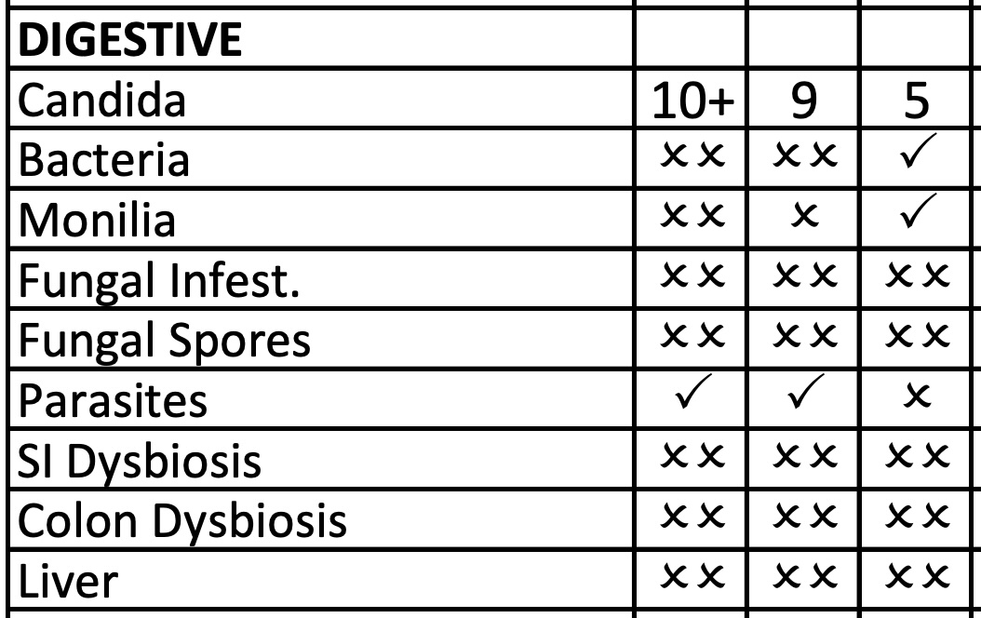
Case #2 — TT - Histaminic, Systematic, Microbic (dysbiotic)
O// (4th visit, July 2024)
Updated Vega
Hives

Slide 36
Case #2 — TT - Histaminic, Systematic, Microbic (dysbiotic)
P// (4th visit, July 2024)
Discussed ongoing mold exposure at home is most likely the leading factor in the ongoing skin reactions
Possible elm (slippery elm) reaction w/ environmental cross-reactivity of pollens... if you suspect oral slippery elm is triggering then discontinue
UPDATED Phenolic [Candida+, Enzyme+, Lymphexx, Dermexx, Parasites, Virus, Fungexx, Histamine, HPAM, Livexx, System Detox]: 5 drops 2x/day and increase by 5 drops 2x/day every few days until reached full dose of 15 drops 2x/day
Indication: phenolic for ongoing support for candida and dysbiosis
SISU Cal Mag Citrates Liquid with D3, (Blueberry Parfait or alternative flavour) 450 mL: TAKE 1/4-1/2 tsp 3x/day with meals (store in fridge)
[500mg Calcium / 1 Tbsp - per 1/4-1/2 tsp = 41.5 - 83mg; 3 doses per day = max 250mg supplemental per day
Indication: to block absorption of oxalates
Continue other items (dispensed marshmallow root powder in place of slippery elm d/t possible rxn)

Slide 37
Case #2 — TT - Histaminic, Systematic, Microbic (dysbiotic)
S// (5th visit, Sept 2024)
got mold in home remediated
skin is doing much better, but new type of skin rxns (round odd patches)
the asthma is gone! hasn't needed the puffer - thinks it was the pollen in the air
hives have significantly improved – very few random occasions
tried the Ca/Mg liquid; flared after used it

Slide 38
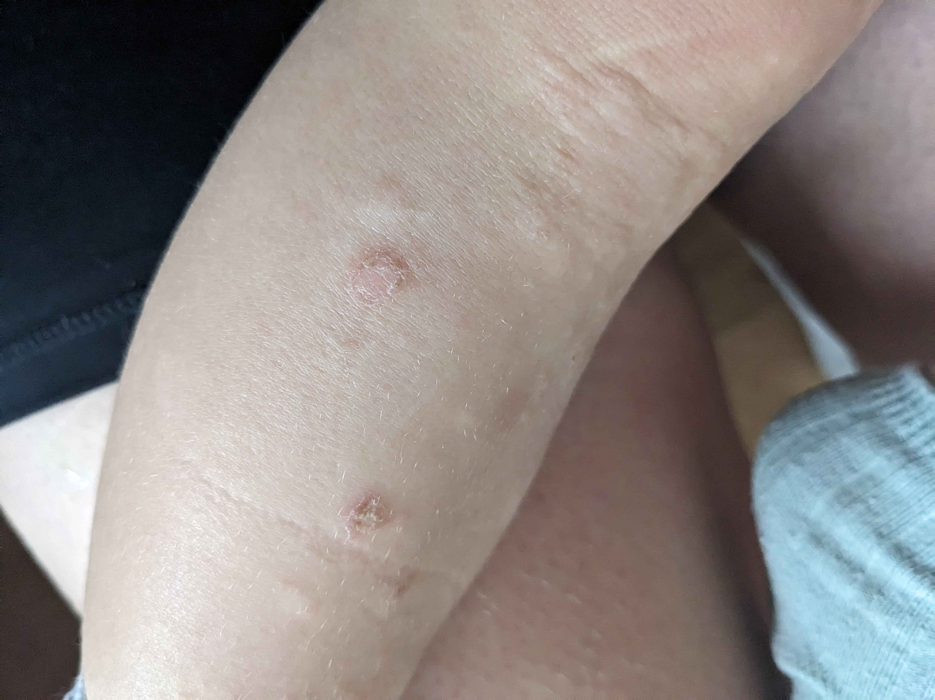
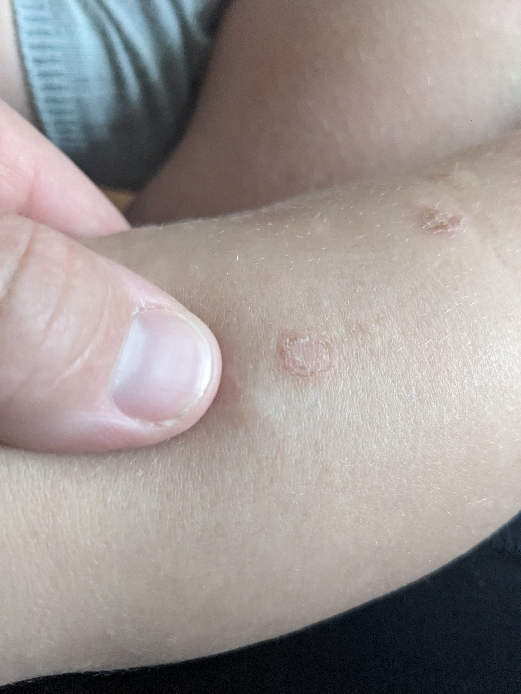
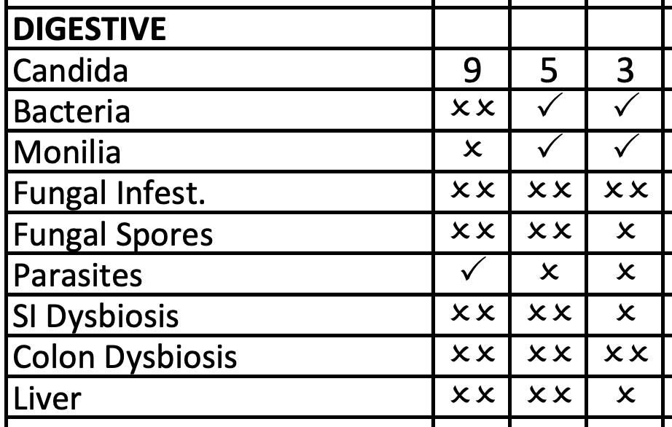
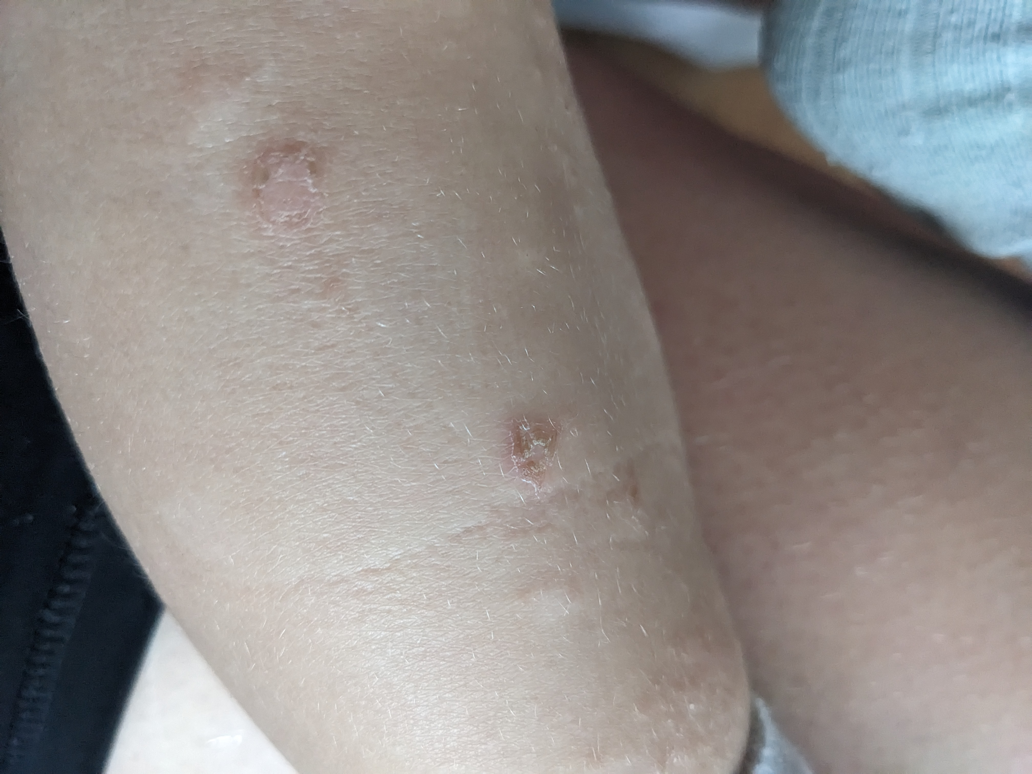
Case #2 — TT - Histaminic, Systematic, Microbic (dysbiotic)
O// (5th visit, Sept 2024)

Slide 39
Case #2 — TT - Histaminic, Systematic, Microbic (dysbiotic)
P// (5th visit, Sept 2024)
Maintain on plan

Slide 40
Case #2 — TT - Histaminic, Systematic, Microbic (dysbiotic)
S// (6th visit, Oct 2024)
skin: has been ok; better than has been; new area across shoulders (and upper back); a few of those red spots on legs; overall creases much better
no more of the hives
diet: doing okay; hasn't been trying new foods; reacts a little to quinoa but keeping; able to eat full banana, raspberries as well
feels things have plateaued; still on restrictive diet
HPAM helping w/ the flares
manuka honey and oil of oregano oil in the bath; neem oil
looks healthy; more thin

Slide 41
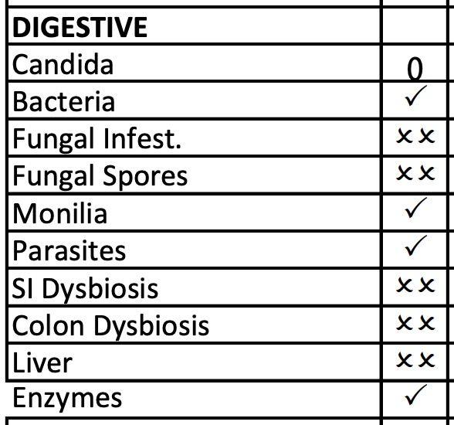
Case #2 — TT - Histaminic, Systematic, Microbic (dysbiotic)
O// (6th visit, Oct 2024)
Updated Vega

Slide 42
Case #2 — TT - Histaminic, Systematic, Microbic (dysbiotic)
P// (6th visit, Oct 2024)
Recommended MOAT or full OAT to query clostridia status
Continue to try and in more foods; if skin flares you can manage with the Baby Borage Cream and even a touch of the steroid if really flares up
Discussed above testing options as it seems we have hit a plateau with the skin/immune health; discuss possible clostridia, mycotoxins
Discussed 6 weeks trial w/ the phenolic containing heavy metal detox support; if no changes then consider the above testing options (we can discuss at his next phone call)
UPDATED 10-23-24 Phenolic [Infla, Intra-Cell, Fungexx, Lymph1, Relief+G12, SystemDetox, H'metals]: 5 drops 2x/day and increase by 5 drops 2x/day every few days until reached full dose of 15 drops 2x/day
Indication: phenolic for ongoing support for candida and dysbiosis + heavy metal support
Baby Borage Eczema Cream 60ml (Wild Carrot): apply to eczema areas once or twice daily; use on test area first
Indication: skin
measurements (weight, height) when in for next in-person appointment

Slide 43
Case #2 — TT - Histaminic, Systematic, Microbic (dysbiotic)
S//
called in – flare up of skin (mom suspects candida flare)
Would like to go ahead with the OAT
P//
Pleo Alb: start at 1 drop once daily and increase by 1 drop each day until reached full dose of 5 drops once daily. Take directly or mix into splash of water.

Slide 44
Case #2 — TT - Histaminic, Systematic, Microbic (dysbiotic)
S// (7th visit, Jan 2025)
skin still very reactive
Nasalcrom (Cromolyn) topical has helped w/ the itching and redness
creases have been so bad!
no behavioural concerns
good sleep
digestion: good BMs BID; well-formed and normal
having more foods: mangoes, blackberries; has also had chickpeas, beans; has tried all the tree nuts; tries avocado and salmon once weekly (but gets red, itchy)
will do a wellness check w/ GP to get assessed
was sick last week w/ fever; did well; lost some weight

Slide 45
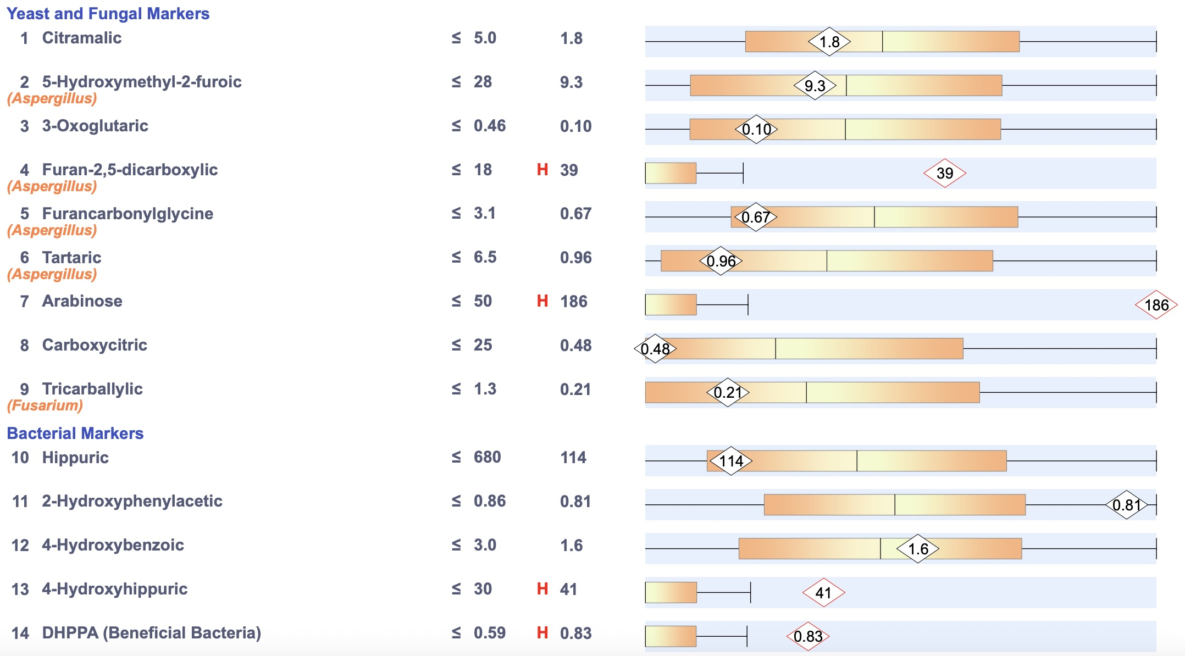
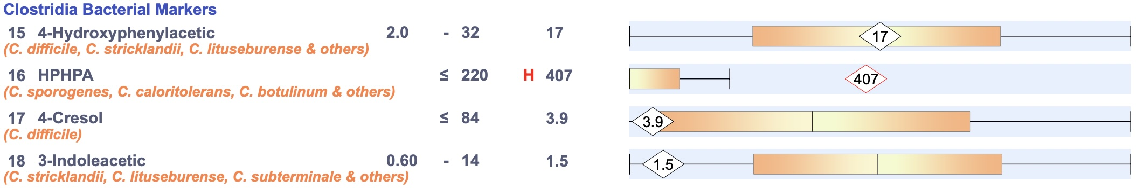
Case #2 — TT - Histaminic, Systematic, Microbic (dysbiotic)
O// (7th visit, Jan 2025) OAT

Slide 46
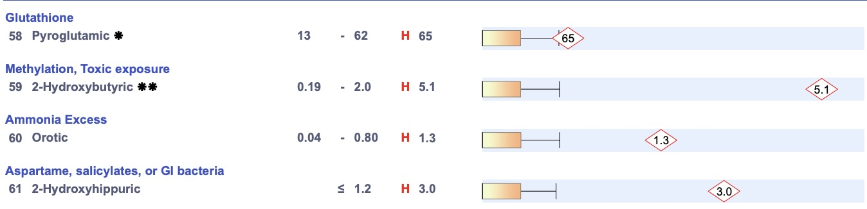
Case #2 — TT - Histaminic, Systematic, Microbic (dysbiotic)
O// (7th visit, Jan 2025) OAT

Slide 47
Case #2 — TT - Histaminic, Systematic, Microbic (dysbiotic)
P// (7th visit, Jan 2025)
NDF Calm: 5 drops twice daily; increasing by 5 drops every few days until reached 20 drops twice daily
Indication: liver + detox support
NDF Happy: 5 drops twice daily; increasing by 5 drops every few days until reached 10 drops twice daily
Indication: anti-candida; anti-fungal support
Quercetin (Vital Nutrients or Natural Factors): 1/2 cap daily - increasing to 1 cap 2x/day if skin is flaring
Pause:
  Probiotics
  Marshmallow root powder
  Butyrate (sun butyrate)

Slide 48
Case #2 — TT - Histaminic, Systematic, Microbic (dysbiotic)
S// (8th visit, Feb 2025)
thinks the candida has calmed down; skin is improved; athlete's foot has resolved which persisted
bowels are regular
P//
Per OAT, layering in support for the B Vitamin imbalances, clostridia, and additional candida support
S Boulardii SAP: 1/2 cap once daily opened into water or fruit sauce; increase to 1 full cap daily; adjust if constipation (store in fridge)
Indication: to address clostridia
Has at home (new label for long-term dosing): Uva Ursi Glycerite: 15-20 drops 2x/day in splash of water (store in fridge)
Indication: bacterial overgrowth/imbalances per OAT
Vitamin B Coenzyme Complex: 10-15 drops once daily around a meal; can be added to warm water or taken directly; store room temp
Indication: B vitamins to address the imbalances in the OAT **can flare up behavioural or skin symptoms, usually when the system becomes "over-saturated with B Vitamins". If you suspect this, then pause for 1 week and then re-start.

Slide 49
Case #2 — TT - Histaminic, Systematic, Microbic (dysbiotic)
S// (9th visit, Mar 2025)
skin: got worse last week (unsure if the raw pear triggered OR if related to the B vitamins)
skin is up and down; bad spots are still quite itchy; red spots cleared
has been working through the supplements
gaining weight well - saw GP - 95th percentile wt and ht
talking well
genetic factor - TT has 50% chance of having DSP gene, which encodes desmoplakin (possible cardiomyopathy); biological father has been dx
characteristics are chapped feet; curly hair (has both); will get cardio screening

Slide 50
Case #2 — TT - Histaminic, Systematic, Microbic (dysbiotic)
P// (9th visit, Mar 2025)
Biocidin LIQUID
DOSING:
— start at 1 drop once daily; work up by adding an extra drop every day until reached full dose of 5 drops twice daily; after reached full dose then continue full dose of 5 drop twice daily for 14 days and then change to taking that dose (5 drops 2x/day) every 3 days for a full 1 month
— can be added into juice or water; lower to previous dose if bothers stomach
Indication: to address clostridia
Continue other items

Slide 51
Case #2 — TT - Histaminic, Systematic, Microbic (dysbiotic)
S// (10th visit, Apr 2025)
was showing improvements x 2 weeks then flared over this weekend
is adding in new foods - unsure if triggered; also some enviro factors w/ the spring
has tried cashews, almonds
biocidin q 3 days - went really slow at the beginning; taking 5 drops 2x/day + the NDF Calm
BMs are regular - 2-3 daily; good consistency
will get info about the DSP gene (cardiomyopathy) in a few weeks

Slide 52
Case #2 — TT - Histaminic, Systematic, Microbic (dysbiotic)
P// (10th visit, Apr 2025)
Finish up (don’t refill) Coenzyme B Complex
Finish up and then pause NDF Calm and Biocidin (pause cycling before MOAT re-test)
Monitor MOAT to track clostridia

Slide 53
Case #2 — TT - Histaminic, Systematic, Microbic (dysbiotic)
S// (11th visit, June 2025)
Skin: “98% clear!” finally cleared behind the ears, only slightly red around mouth and hips (has been eating a lot new foods)
has been having some strawberries, watermelon
recalls last year at this time did clear
doing well; growing well — good appetite; two large BMs daily
ate mixed nuts - was fine
going to try the egg muffin again
hasn't been in touch w/ the allergist – if any reactions then will try and see the allergist again
tested positive for CSP gene – will go in every year for ECG and echo; then when old enough will get yearly MRI
pediatric CPR training; lots of unknowns; proactive CV approach

Slide 54
Case #2 — TT - Histaminic, Systematic, Microbic (dysbiotic)
S// (12th visit, Mar 2026) — delay from last visit
thinks the biocidin made a great difference!
he is eating pancakes with real flour and eggs; most variety in foods
home has been remediated (there could still be some mold in the kitchen); they are looking to move in the next two years
he uses quercetin daily: 1 cap 2x/day; when they cut back then more itching
behaviour: he has been great
sleep: good; he dropped his nap
digestion: good BMs, still having 2 good poops daily (no frothy poops for a while)
Asthma is completely gone

Slide 55
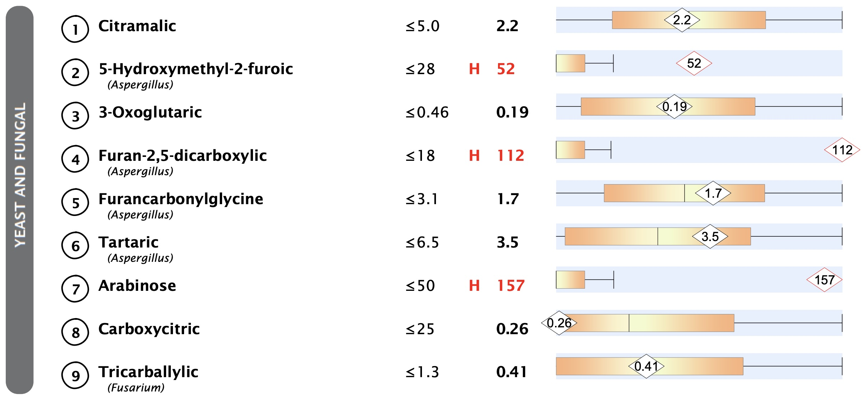
Case #2 — TT - Histaminic, Systematic, Microbic (dysbiotic)
O// (12th visit, Mar 2026) — opted for full OAT re-test
PREVIOUS OAT
UPDATED OAT

Slide 56
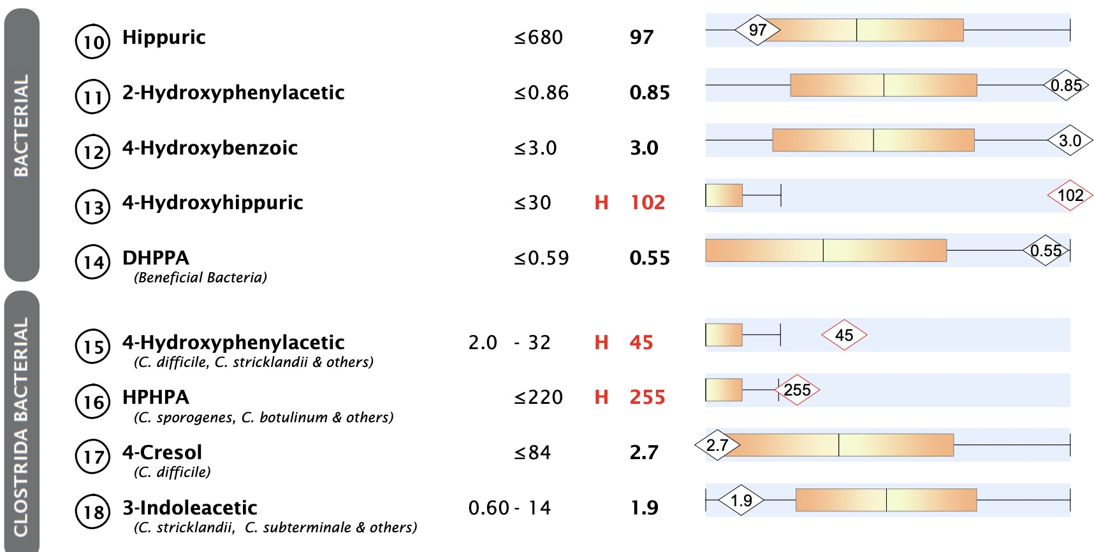
Case #2 — TT - Histaminic, Systematic, Microbic (dysbiotic)
O// (12th visit, Mar 2026)
PREVIOUS OAT
UPDATED OAT

Slide 57
Case #2 — TT - Histaminic, Systematic, Microbic (dysbiotic)
O// (12th visit, Mar 2026)
UPDATED OAT
Oxalate dumping?
PREVIOUS OAT

Slide 58
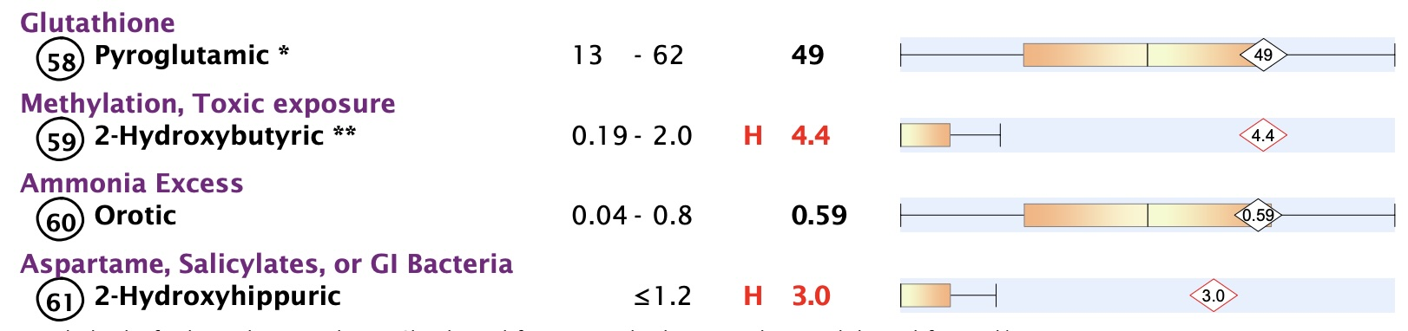
Case #2 — TT - Histaminic, Systematic, Microbic (dysbiotic)
O// (12th visit, Mar 2026)
UPDATED OAT
PREVIOUS OAT

Slide 59
Case #2 — TT - Histaminic, Systematic, Microbic (dysbiotic)
P// (12th visit, Mar 2026)
If any reactions (skin itching etc), then slow detox/gut treatments down.
As tolerated, start adding in anti-fungal culinary herbs to foods/cooking (e.g. thyme, garlic, oregano, rosemary etc)
Energizing Chlorophyll: work up to full dose of 5 drops 2x/day in water or fruit sauce
Indication: detox/binder for the mold (and presumptive mycotoxins)
Pro-Myco: 1 drop once daily and slowly titrate dose up to full dose of 5 drops 2x/day - best taken directly or in splash of water (not in food/juice)
Indication: anti-mold formula

Slide 60
Case #2 — TT - Histaminic, Systematic, Microbic (dysbiotic)
P// Continued (12th visit, Mar 2026)
REFILL: Biocidin Liquid: Start at 1 drop once daily; work up by adding an extra drop every day until reached full dose of 5 drops twice daily; after reached full dose then continue full dose of 5 drop twice daily for 14 days and then change to taking that dose (5 drops 2x/day) every 3 days until bottle is completed
REFILL NDF Calm: 5 drops twice daily; increasing by 5 drops every few days until reached 20 drops twice daily
Quercetin: 1 cap 2x/day as needed for nighttime itching
Vitamin D/K2 drops
REFILL Vitamin B Coenzyme Complex: 10-15 drops once daily around a meal; can be added to warm water or taken directly; store room temp

Slide 61
Case #2 — TT - Histaminic, Systematic, Microbic (dysbiotic)
S// (13th visit, Apr 2026)
skin flared a bit at first; getting to the end of the first bottles (energizing chlorophyll, pro-myco)
P//
Do another round of the Biocidin, NDF Calm, Energizing Chlorophyll and finish up the current bottle of the Pro-Myco.
Then switch to NDF Happy and NEW Probiotics (HMF).
Trial multivitamin
Next visit booked for August 2026

Slide 62
Questions?
Thank you!

